Slide 1
SRM INSTITUTE OF SCIENCE AND TECHNOLOGY Dept. of Computer Science and Engineering · Design and Innovation Club
NLP HACKATHON 2026
KuralAI
Expressive Tamil Audiobook Generator
TEAM · KuralAI
Sricharan Suresh RA2311003040063
Mani Shankar B RA231003040045
Jai Vignesh B RA231003040020

Slide 2
PROBLEM STATEMENT 3
Expressive Tamil Audiobook Generator
An intelligent Text-to-Speech system that converts Tamil stories and literature into expressive, emotion-aware audiobooks — narrated with distinct character voices and broadcast-ready audio quality.
1
Natural Speech
2
Emotion-Aware
Proper Tamil pronunciation & flow
Joy, sorrow, anger, fear, surprise
3
Character Voices
4
Commercial Quality
Distinct voice per speaker
Classical & modern literature, broadcast audio
80M+
Tamil speakers worldwide — still underserved by expressive TTS
KuralAI
02 / 10

Slide 3
PROBLEM ABSTRACT
Tamil Deserves More Than Monotone TTS
Tamil TTS today produces flat, monotone speech that strips away the emotional richness of Sangam poetry and modern fiction alike. KuralAI pairs a lightweight, rule-based emotion tagger with neural TTS to deliver narration that respects the source material's dramatic intent — without requiring GPU-heavy models.
80M+
6
0
Tamil speakers with no expressive TTS option
Emotion categories detected per segment
GPUs required — runs on any device
EXISTING TAMIL TTS
KURALAI APPROACH
Flat, monotone delivery · Single generic voice · Ignores emotional context in the text
Emotion-aware prosody · Distinct multi-character voices · Lightweight, edge-friendly pipeline
KuralAI
03 / 10

Slide 4
PROPOSED SOLUTION
A Four-Stage Pipeline Architecture
1
2
3
4
Text Preprocessing
Emotion Tagging
Voice Assignment
Neural TTS Synthesis
Normalize Tamil Unicode, segment sentences, detect dialogue vs. narration.
Rule-based keyword & regex classifier — 6 emotion categories, zero ML overhead.
Map characters to distinct voice profiles by pitch, speed & timbre.
edge-tts renders emotion-tuned prosody into final audiobook audio.
Modular design — TTS backend can be swapped as stronger Tamil neural models emerge.
KuralAI
04 / 10

Slide 5
SYSTEM DESIGN
End-to-End Data Flow
INPUT
PREPROCESS
EMOTION TAG
VOICE ASSIGN
TTS OUTPUT
Raw Tamil text
(.txt / .docx)
Unicode normalize
Sentence segment
Dialogue detect
Keyword + regex
6 categories
Character ID
Pitch / speed profile
Neural synthesis
Emotion prosody
.mp3 / .wav
Fig. 1 — End-to-end pipeline: Tamil text → expressive audiobook
KuralAI
05 / 10

Slide 6
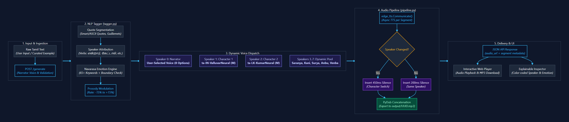
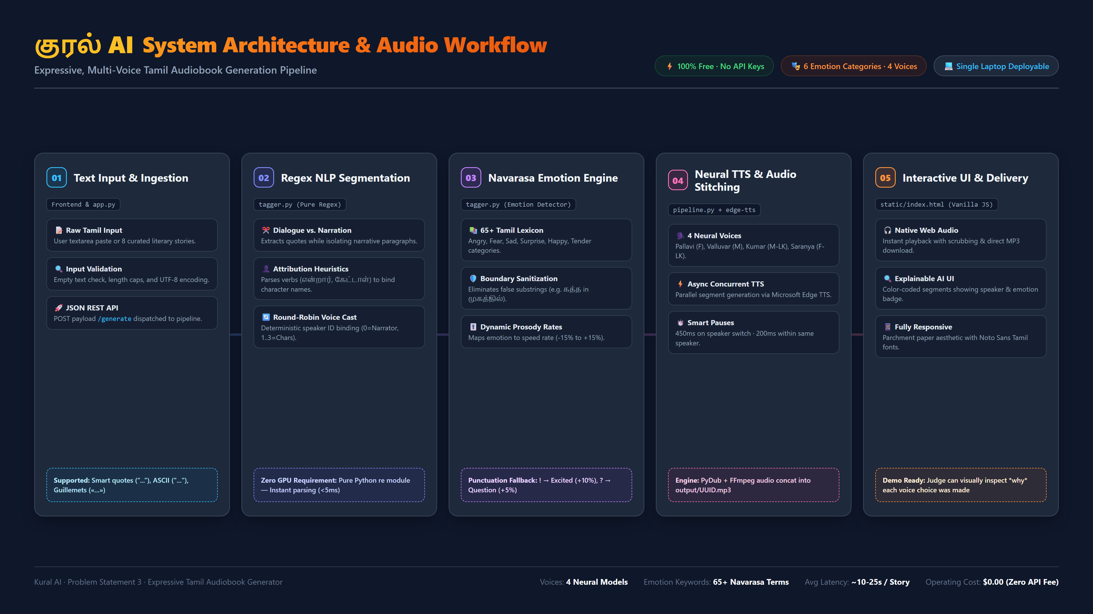
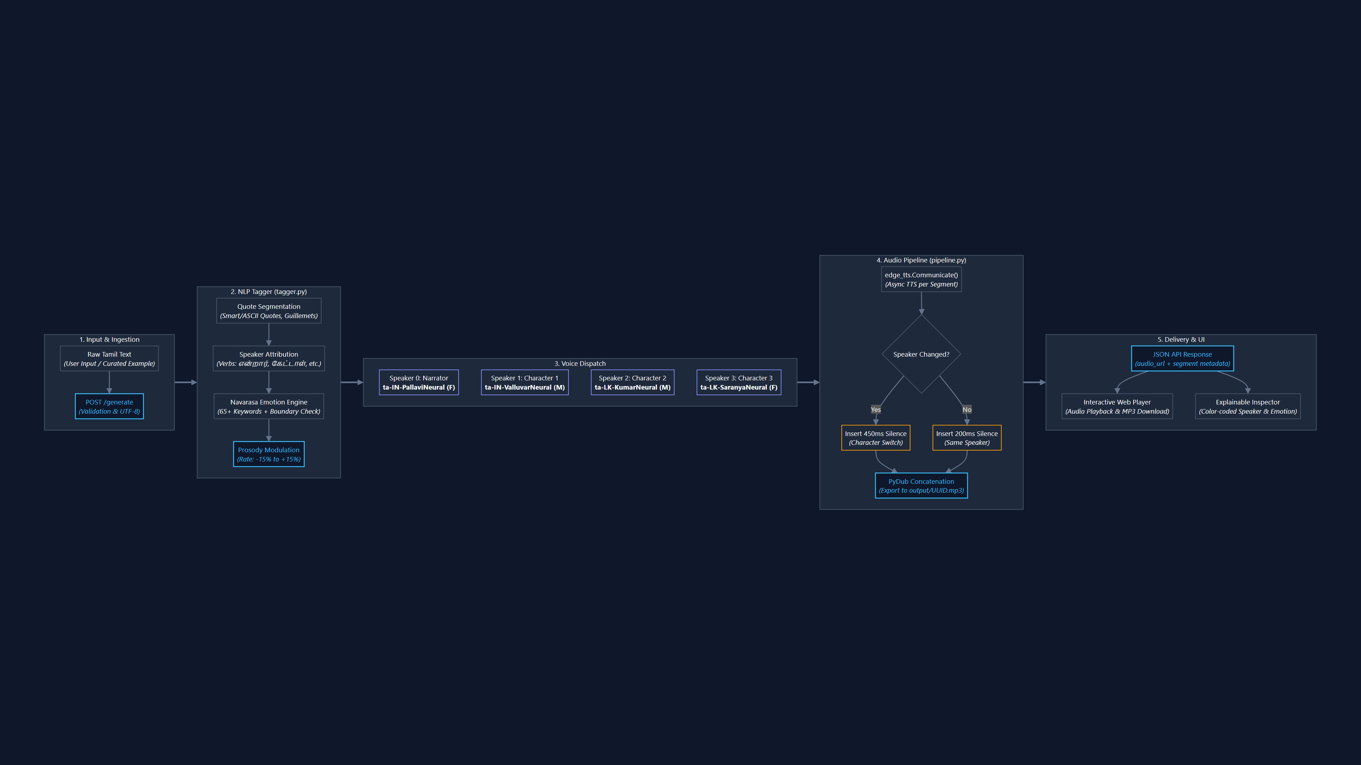

Slide 7
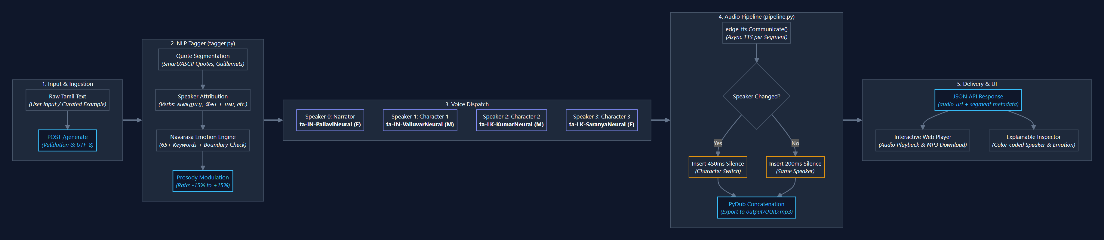

SYSTEM DESIGN · DETAILED VIEW
Pipeline Logic & Voice Dispatch
From raw text ingestion through speaker attribution, emotion tagging, voice dispatch, and silence-aware audio stitching to final delivery.
Fig. 2 — Detailed pipeline logic: ingestion → tagging → voice dispatch → stitched audio → delivery
KuralAI
07 / 10

Slide 8
WORKING PROTOTYPE · PLANNED FOR ROUND 2
From Text to Audiobook, Live
Demo Features
Tech Stack
1
Upload or paste a Tamil story / poem excerpt
Frontend
HTML / CSS / JS
2
Real-time, color-coded emotion tagging view
Backend
Python (Flask)
NLP
NLTK + custom Tamil tokenizer + regex tagger
3
Character voice assignment panel
TTS
edge-tts — Microsoft neural voices, free, no API key
4
Synced playback + downloadable .mp3
Audio
pydub — concatenation & format conversion
Browser UI
Flask Backend
NLP + Emotion Tag
edge-tts Synthesis
Audio Output
KuralAI
08 / 10

Slide 9
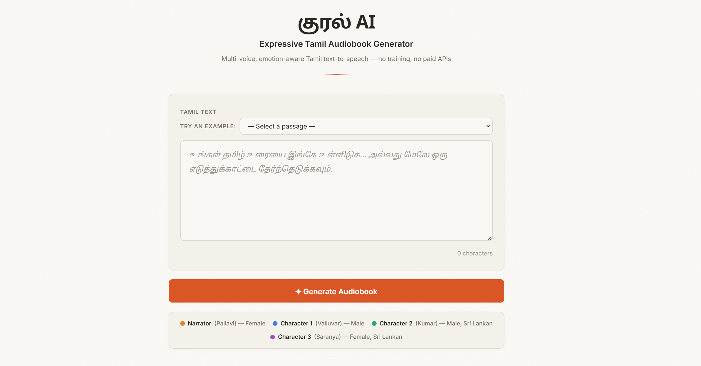
LIVE DEMO
Try It Yourself
The prototype is live — paste Tamil text or pick a sample passage and generate a multi-voice audiobook in the browser.
verycareful.github.io/KuralAI
Live prototype: verycareful.github.io/KuralAI
KuralAI
09 / 10

Slide 10
Thank You
KuralAI · Expressive Tamil Audiobook Generator
Sricharan Suresh · Mani Shankar B · Jai Vignesh B

